Slide 1





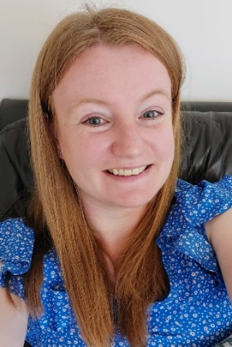

Phonics Screening Check
Information for parents and carers
Year One
Presented by
Miss Lawes and Mrs Watson

Slide 2
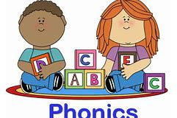
Why is there a phonics screening check?
Taken by all Year One children in England in early June.
Designed to give teachers and parents information on how each child is progressing in phonics.
The inclusion of non-words (alien words) gives a strong indication of your child’s ability to chop and blend, as other strategies (recognition by sight) aren’t available to them. Does your child have the strategies needed to read unfamiliar words?
Assesses your child’s ability to chop and blend all of the sounds learnt in Reception and Year One.
It will help to identify whether your child needs additional support.

Slide 3
How is the check administered?
The check takes place in school, during the normal school day.
Your child will do the check 1:1 with their class teacher, in a quiet room near their classroom.
There will be a few practice words first to make sure your child understands the activity.
The check assesses phonics skills and knowledge learned through Reception and Year 1.
Through regular class activities and mock checks your child will be familiar and confident with the task.

Slide 4
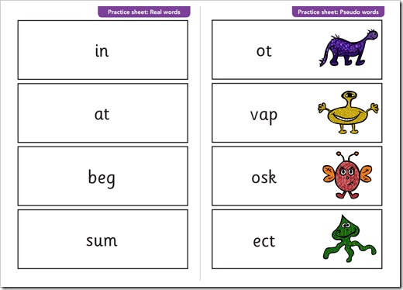
Details of the check
Practice words first
40 words; 4-5 words per page
20 real words and 20 ‘alien’ words
Sound buttons on whiteboards/photocopy
(must be added by the child themselves)
10 -15 minutes
Pass mark approximately 32/40 (varies each year depending on how children across the country have performed that year on that particular check.) – you will get your child’s results by the end of the summer term.
Retakes in Year 2 if necessary.

Slide 5
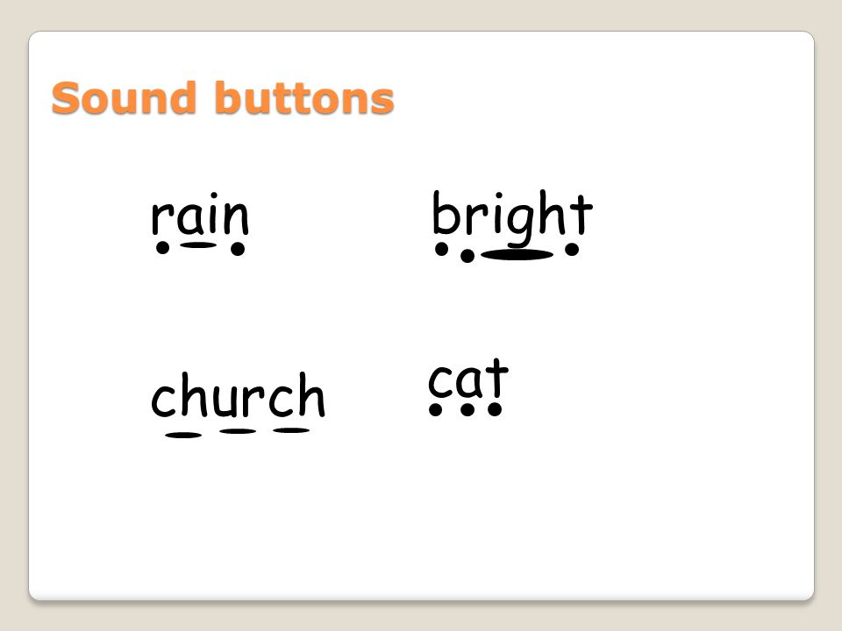
Terminology
44 different phonemes (sounds)
Graphemes are the letters that represent those sounds.
Sound buttons
Chopping and blending
Digraph - 2 letter sound
Split digraph – 2 letter sound where the letters
aren’t adjacent
Trigraph – 3 letter sound

Slide 6
Phases
Phase 1 – developing listening skills through rhythm, rhyme, alliteration, environmental and instrumental sounds.
Phase 2 – the 19 most common single letter sounds
Phase 3 – the remaining single letter sounds and the most common digraphs/ trigraphs. Tricky words
Phase 4 – applying and practising the words taught so far. Tricky words. Consonant blends e.g strong
Phase 5 – alternative spellings for sounds, e.g. ie, i-e, igh. Introduction of split digraph, alternative pronunciations, e.g. soft /c/ in ice

Slide 7
How can you prepare your child for the check?
We aim to work in partnership with you all in providing the best chances for your child. So please take time to find out what support you can offer at home too.
Phase 3 and phase 5 flashcards – these will be issued to children who we feel might benefit from extra practice at home.
Pure sound pronunciation (‘t’ not ‘tuh’)
www.phonicsplay.com Phase 5 is the age-related expectation for Year 1
Sound buttons
https://www.oxfordowl.co.uk/for-home/advice-for-parents/phonics-videos/#animation
Re-read books to build up confidence and fluency. Read at least 4 times a week at home.

Slide 8
How we will prepare your child for the check at school
In November 2021 we carried out an initial mock check with all children. We will continue to monitor your child’s progress through reading activities and phonics lessons.
We will carry out another mock in Spring term.
We used the information from the mock to group the children for their phonics lessons based on their learning needs and next steps
We will share the results of the mock with parents and carers. This can be found in your child’s reading record from week beginning 29th November

Slide 9
What does the score mean at this stage?
The pass mark for the check is generally 32 out of 40.
In the past children who have achieved 20 + on the initial mock have typically gone on to pass in the summer term.
We are aware that the children have missed a lot of schooling and we are focused on filling these gaps and developing their confidence to give them the best possible chance. All children in Year 1 in the UK will be in the same boat!
This year there has been a wide range of outcomes varying from a score of 0 to 40. Every child is different and will develop in their own time.
Please do not worry if you are surprised by the score achieved at this early stage.
In the same way, a high score at this stage does not necessarily indicate that your child should not continue to practice their phonics skills.

Slide 10
Thank you for listening and reading
Please take time to familiarise yourself with the different slides on this presentation and visit the website recommended.
We are always here to answer any queries so please come and see us if needed.
Happy Phonics Practising!

