Slide 1

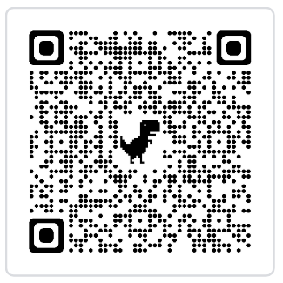
SATs Information Meeting
23rd February 2023

Slide 2
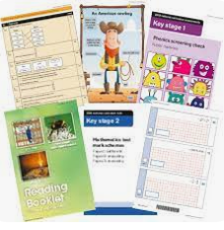
SATs - Standard Assessment Tests
SATs measure children’s educational achievement in Years 2 and 6.
KS1 SATs are just one part of evidence towards the whole teacher assessment.
They are marked in school, and an overall grading based on the whole year’s work will be made.
The results of the SATs tests are reported to the Local Authority.
Moderation often takes place to ensure consistency across schools.
Results will be available in July with your child’s end of year report.

Slide 3
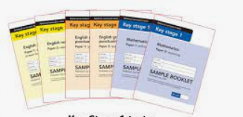
KS1 SATs what they will look like
When?
During May – ideally the middle 2 weeks of the Summer 1 half term but we are permitted to complete them any time.
Please avoid any holidays during this time if possible.
What?
6 papers all together
2 Reading papers
2 Maths papers
1 Spelling paper
1 SPaG paper

Slide 4
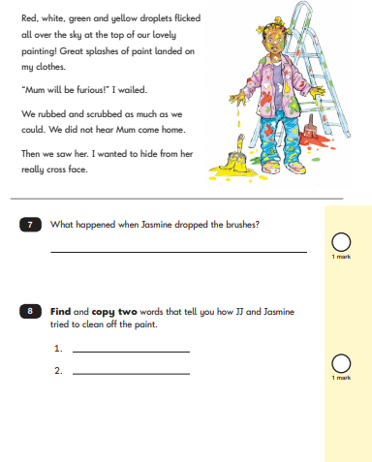
KS1 SATs Reading Papers
Reading Paper 1
Small passages to read, with comprehension questions to answer
at the end of each brief passage.
Reading Paper 2
Separate booklet containing up to 3 different forms of text.
The children will be encouraged to read each story, non-fiction text or poem individually and then answer the questions in the separate answer booklet.
The paper does give the children a guide on where to find the information in the story booklet.

Slide 5
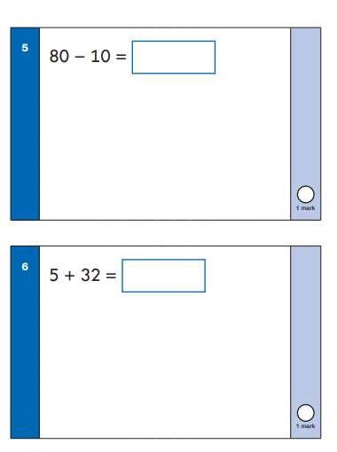
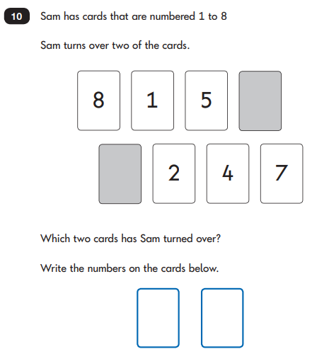
KS1 SATs Maths
Paper 1 – Arithmetic Paper 2
Reasoning and problem solving

Slide 6
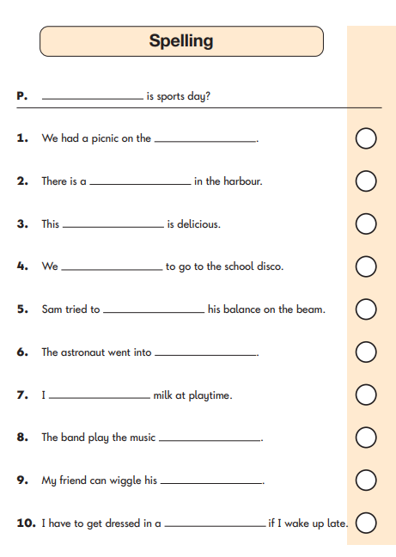
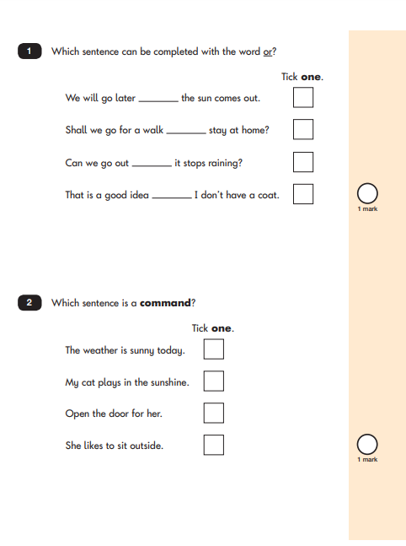
KS1 SATs Spelling and SPaG Papers
Paper 1 - Spelling
Paper 2 – Spelling and Punctuation

Slide 7
How Can You Support?
Read together every day and ask questions about the story [use questions from sheets in reading record that we will supply in due course]
Practise number bonds and times tables.
Use number problems in every day life, at the shops, on the train, telling the time etc.
Continue to work on targets/ areas of improvement.
Keep doing more of what you’re already doing in supporting your child.

Slide 8
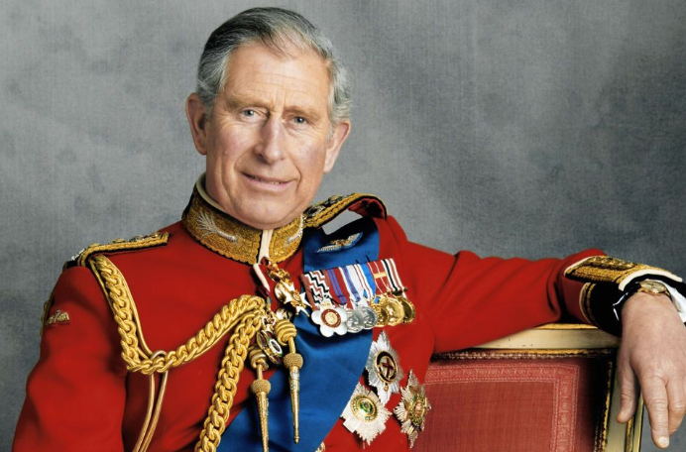
PLEASE DON’T PANIC!!!!!
We have already been practising these subtly and in a relaxed way, dressed up as Quizzes for the King!
Smaller groups for children who may need extra time or fewer distractions
No pressure – we can take as long as we need on these and we stop when your child feels they have completed enough
Thank you for your time today.
We are open to answer any questions that you have.

