Slide 2
What is Seesaw?
Seesaw is a virtual learning platform.
It is like an online learning book – a place for your child to share their learning with their teacher and with you.
Seesaw is a safe and secure platform which is GDPR compliant. When logged in, children can only see their own learning and are only able to interact with their teachers. All posts and comments must be approved by a teacher.

Slide 3
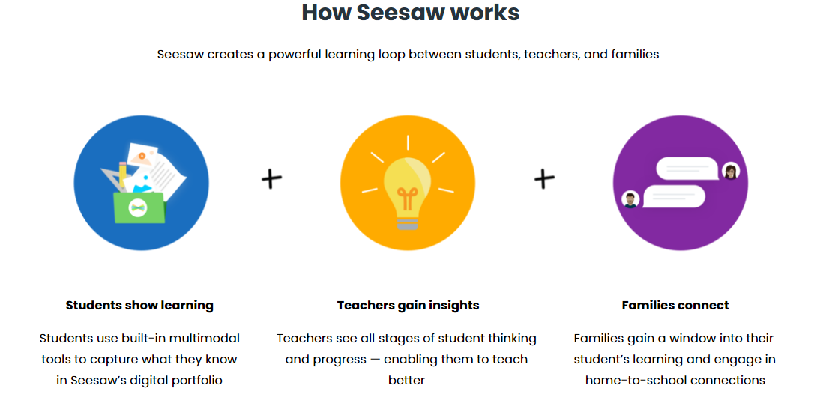
Why use Seesaw?

Slide 4
Why use Seesaw?
Learning at school
Learning links at home (as needed)
Online safety – a safe environment to learn how to use the internet
Develops independence
Preparing for KS2 (formal home learning)
Celebrate learning
Class reminders

Slide 5
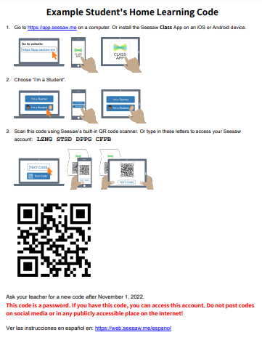
How to use Seesaw
Receive letter with instructions and QR code. The QR code is a password.
On a computer: https://app.seesaw.me
On a phone or tablet: Install the Seesaw Class App
Use the QR code or the letters to log in
Turn on notifications
Wait to be notified of any activities to complete or announcements

Slide 6
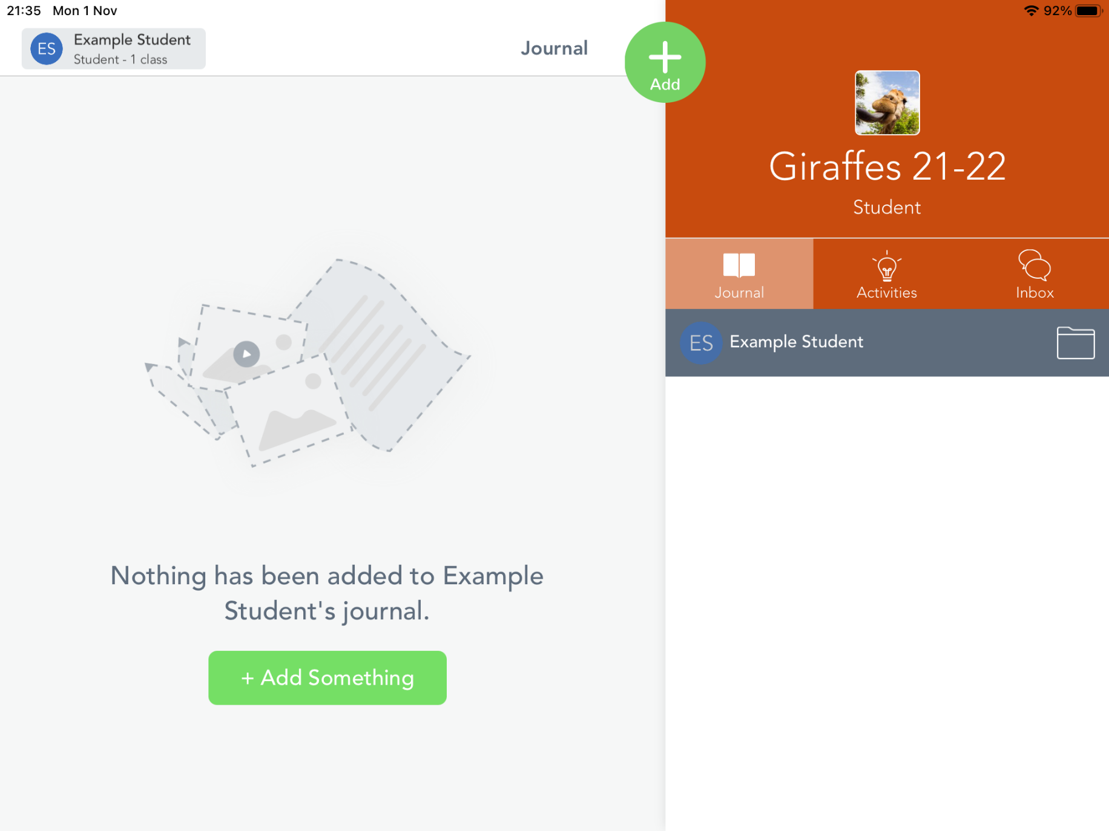
How to use Seesaw

Slide 7
How to use Seesaw
Notification

Slide 8
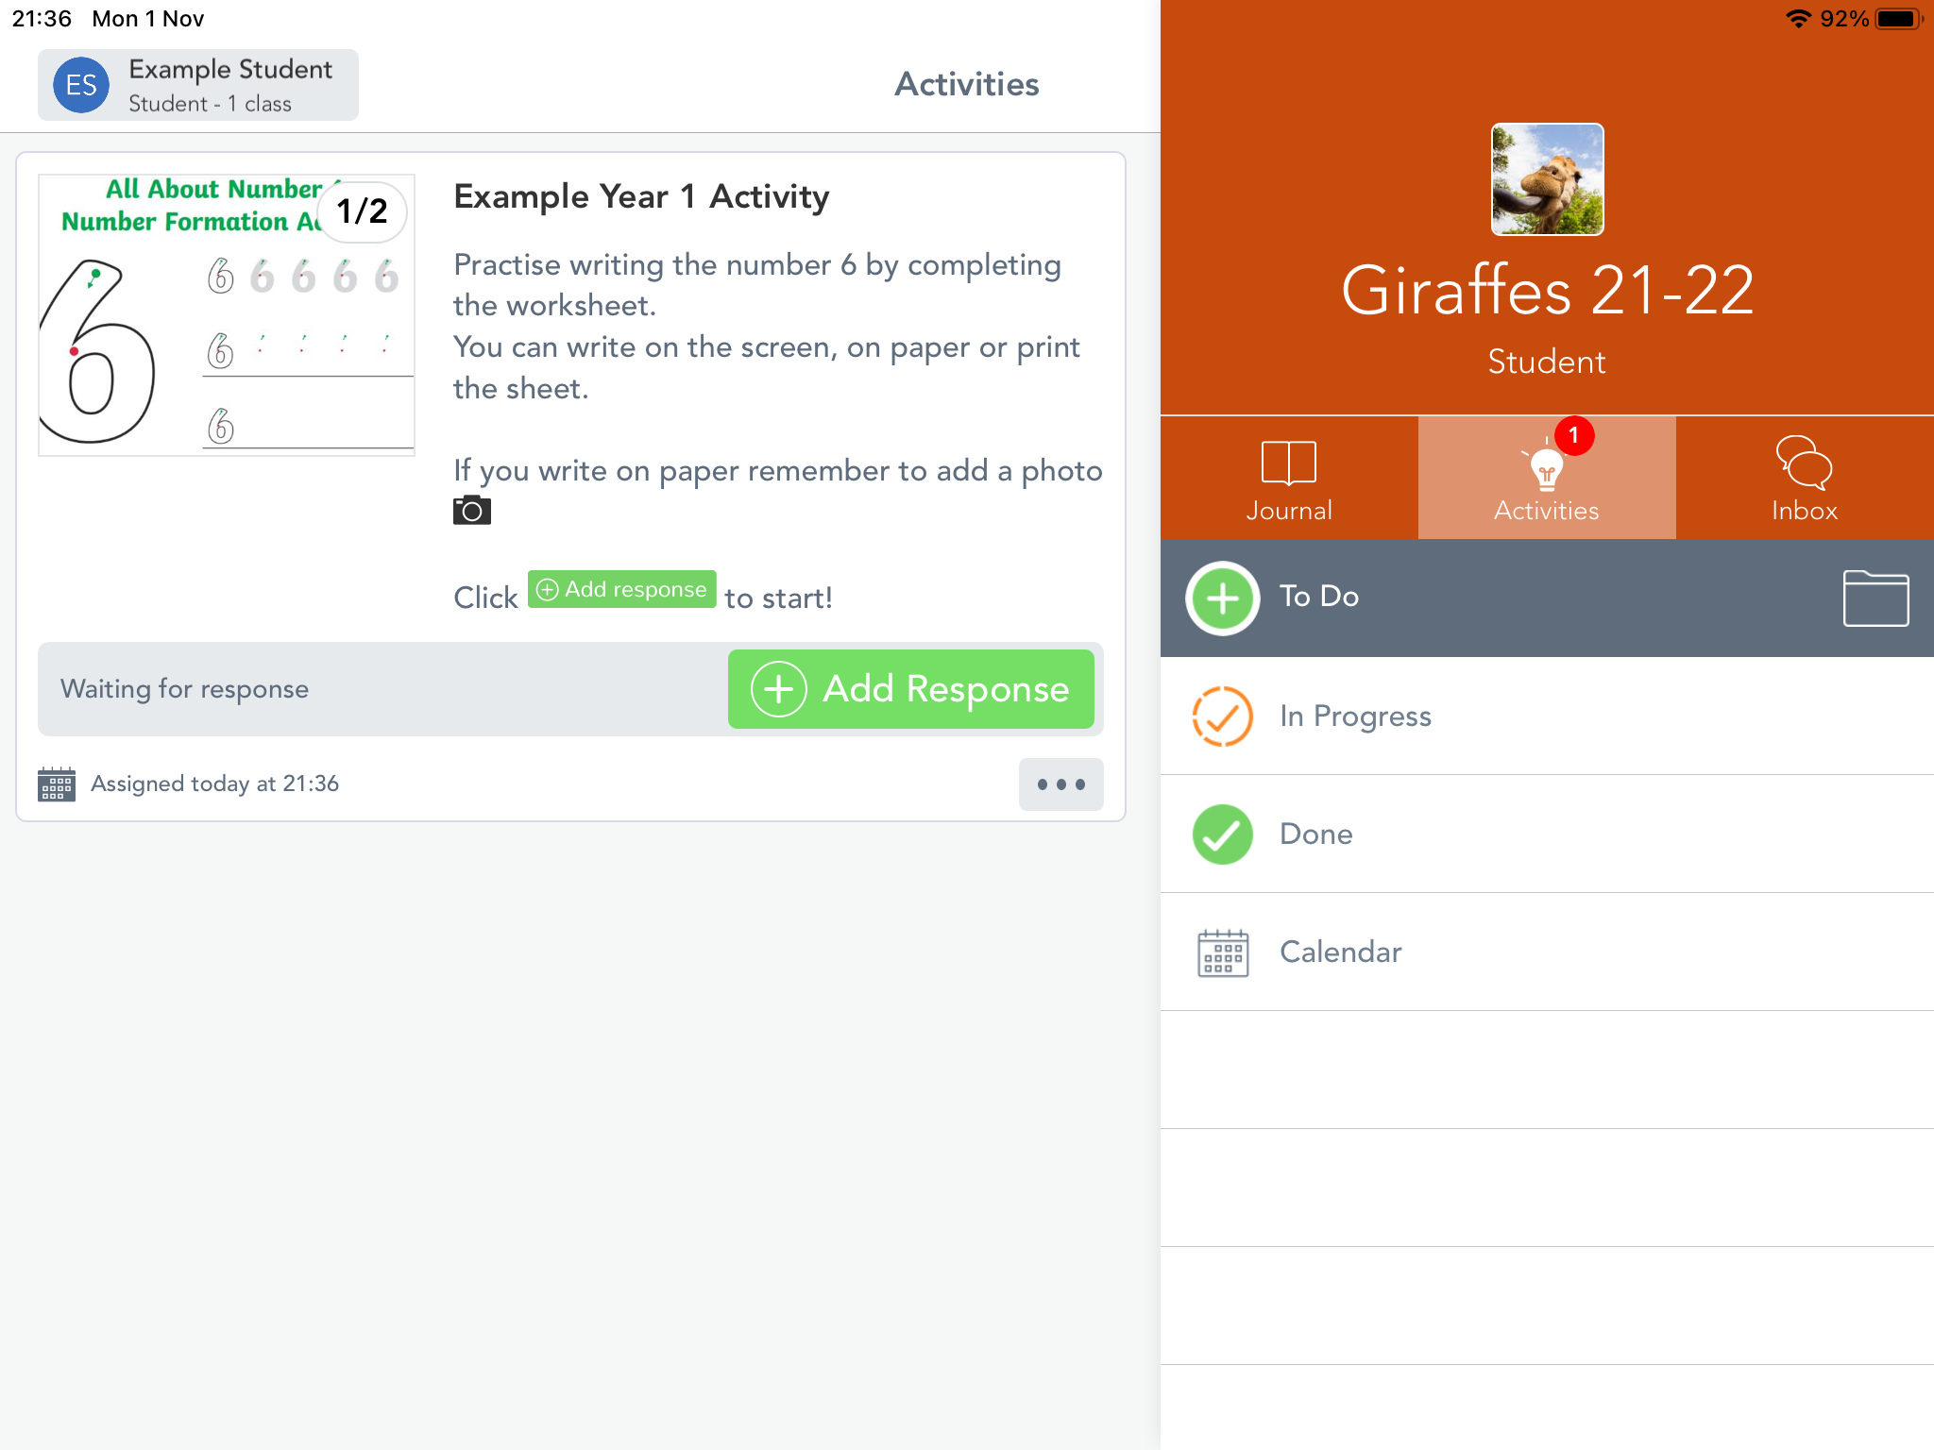
How to use Seesaw
Click on activity
Click on add response (or add)

Slide 9
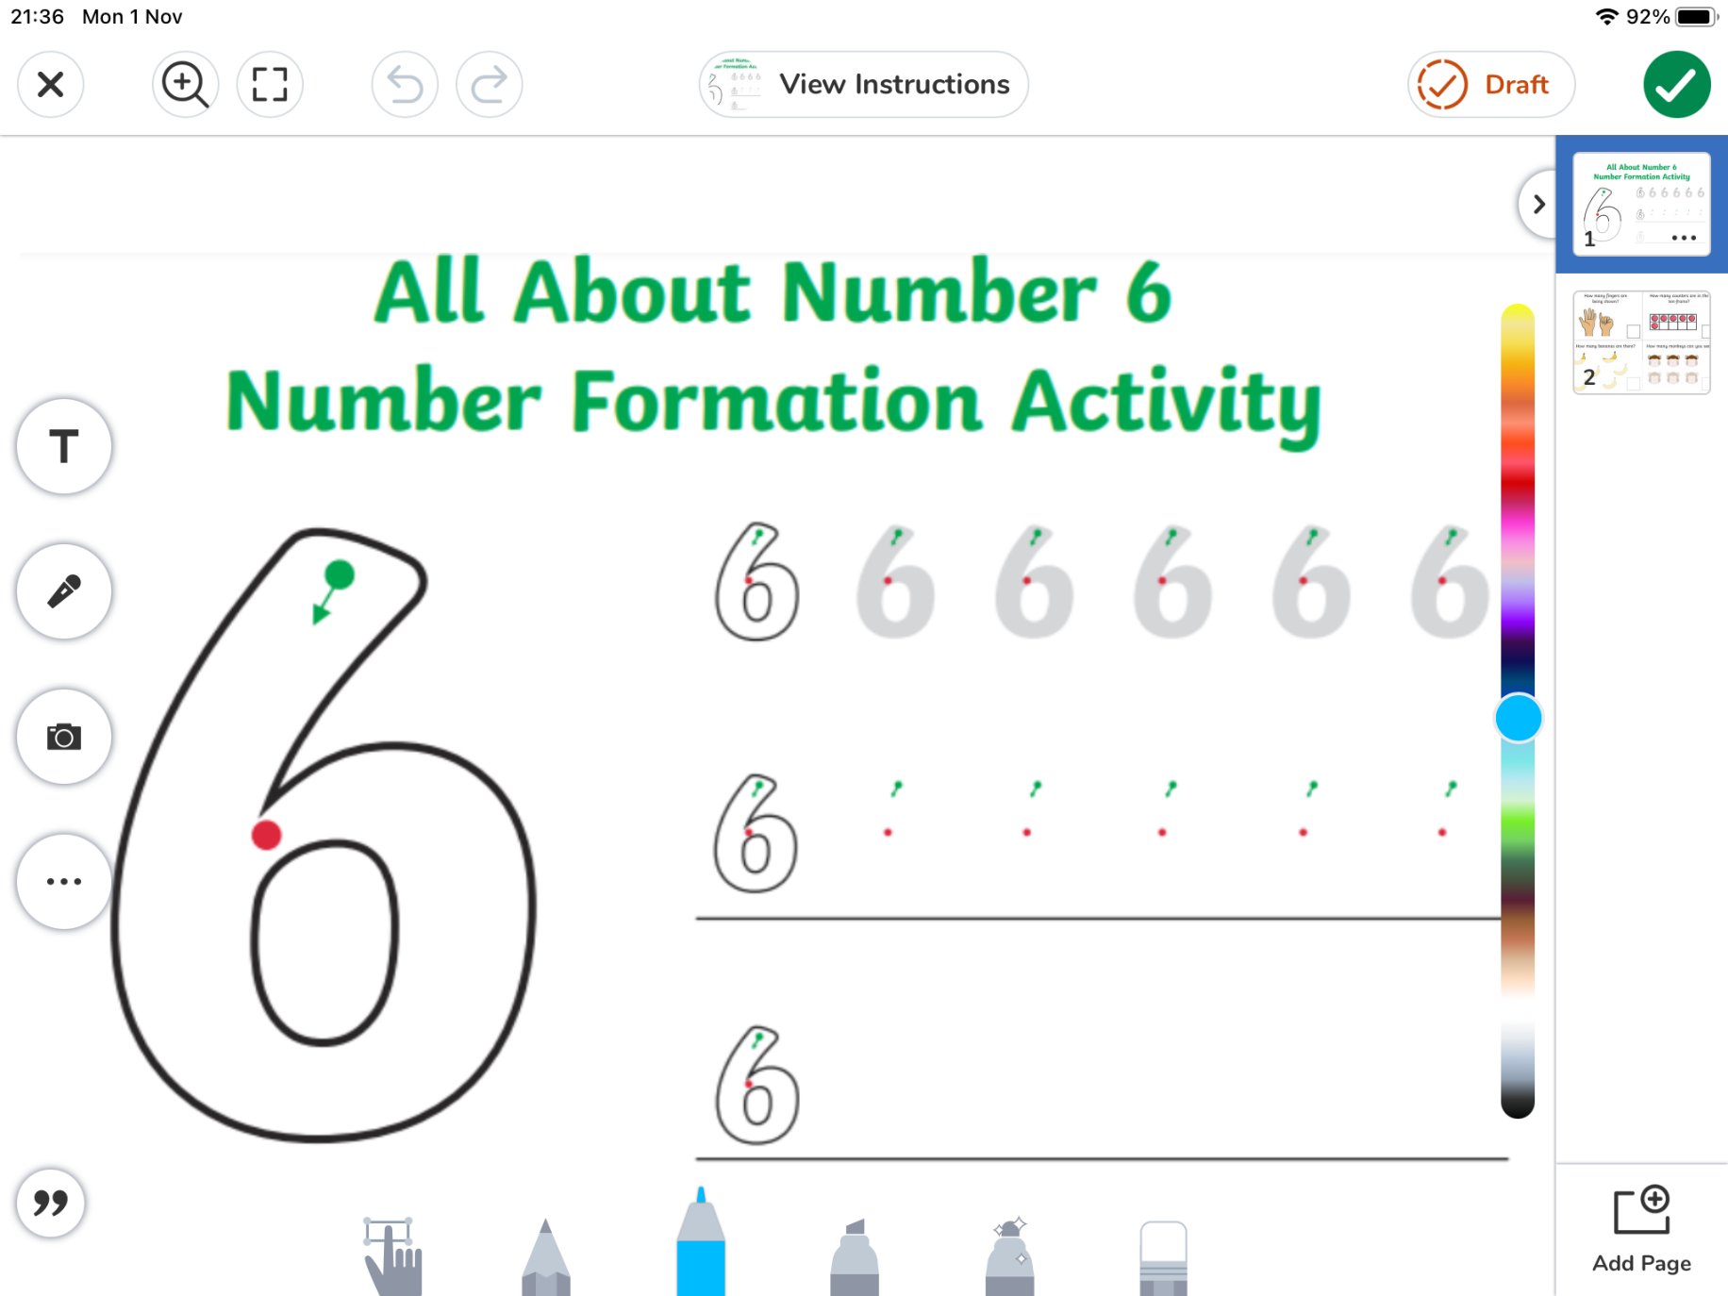
How to use Seesaw
Click the camera to add a photo of learning
Complete the activity with your child

Slide 10
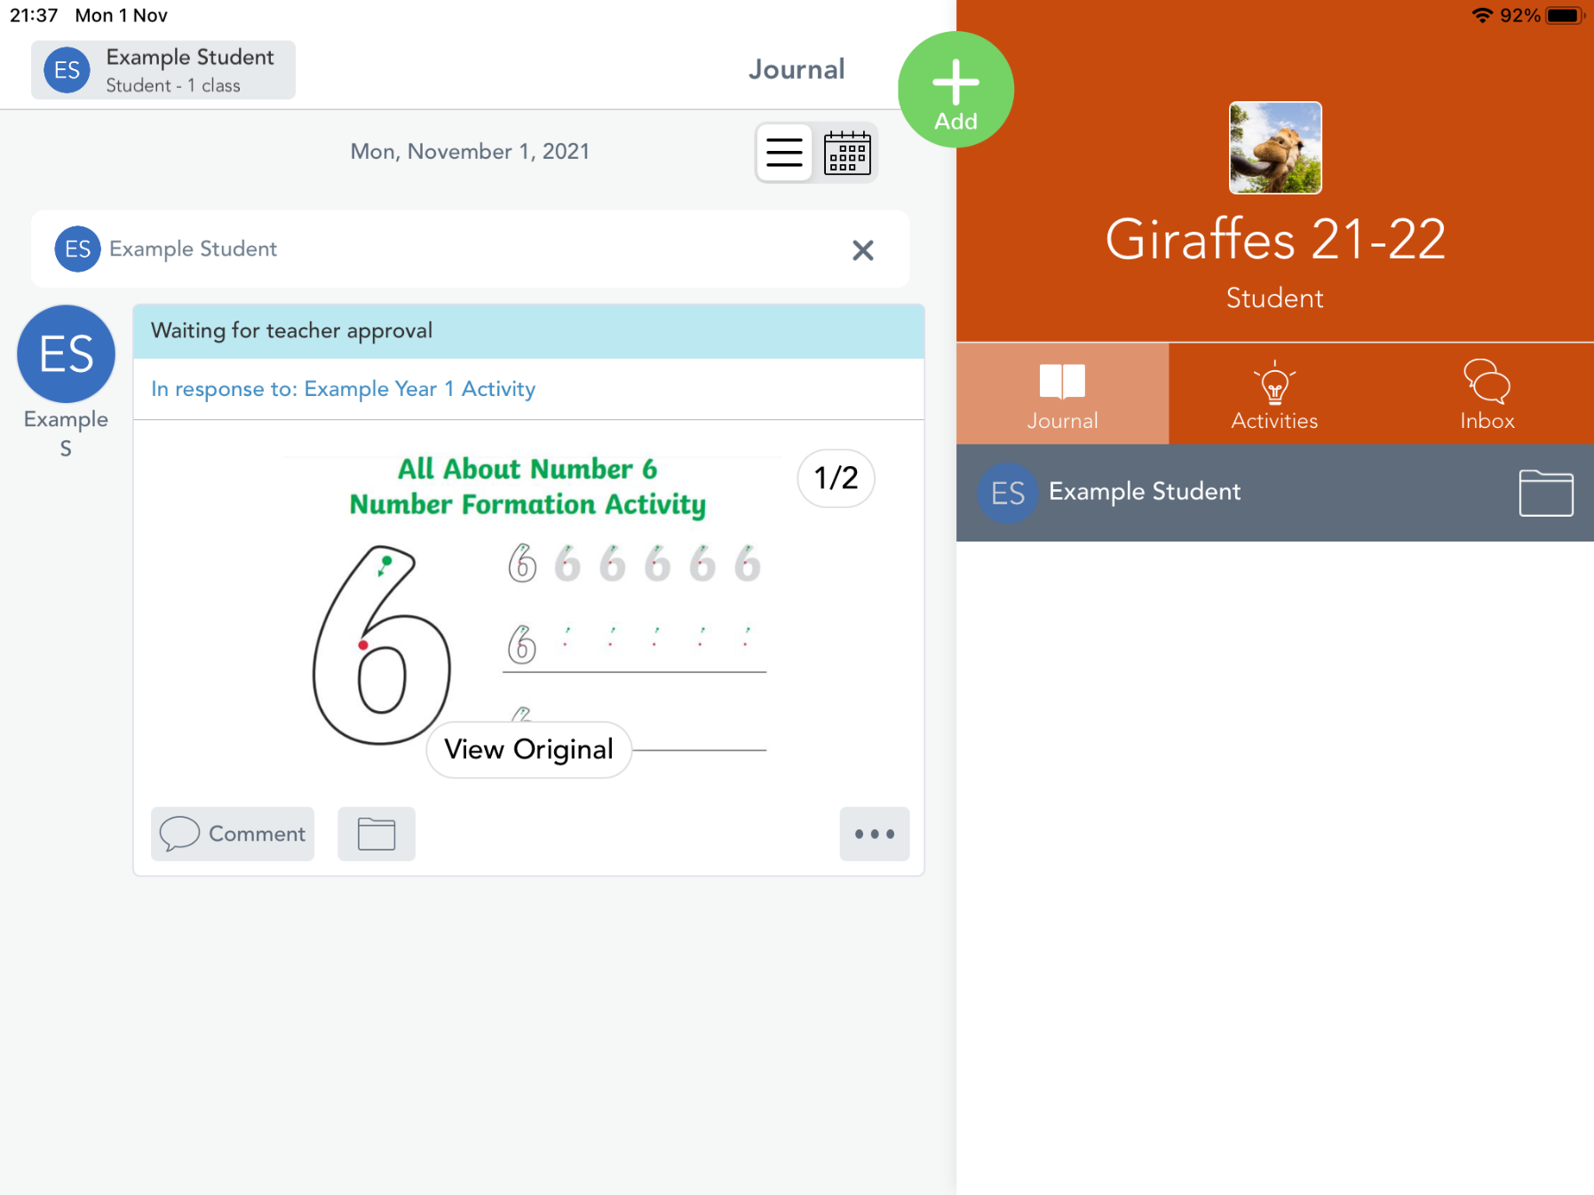
How to use Seesaw
Wait for the teacher to approve and give feedback

Slide 11
How to use Seesaw
Support your child in responding to activities
If work is posted, comment positively on this
Your child will get feedback on their activity, for example a short comment (written or voice recorded), a like or an emoji

Slide 12
Seesaw is not…
A social media site
Use an anonymous profile picture
Keep passwords or QR codes safe
Only use for learning
A way to communicate with your child’s teacher
Email or phone the office if you need to speak to your child’s teacher
Where new information will be shared
Continue to check the newsletter and your emails

